Slide 1
GLOBEL SYSTEM FOR MOBILE(GSM) System architecture
Presented by
Dr. Dhiraj Kumar Patel
Asst. Prof., IIIT Surat.

Slide 2
Contents
GSM-Introduction
Architecture & Interfaces
Technical Specifications
Frame Structure
Protocols used in GSM
Localization and calling
Authentication and Security
Characteristics and features
Applications

Slide 3
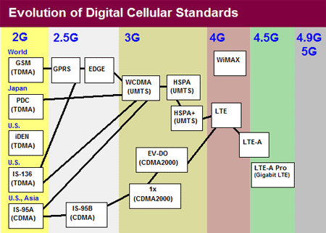
GSM-Introduction
GPRS (General Packet Radio Service)
Enhanced Data rates for GSM Evolution (EDGE)
Wideband Code Division Multiple Access (WCDMA)
High Speed Packet Access (HSPA)
Long Term Evolution (LTE)

Slide 4
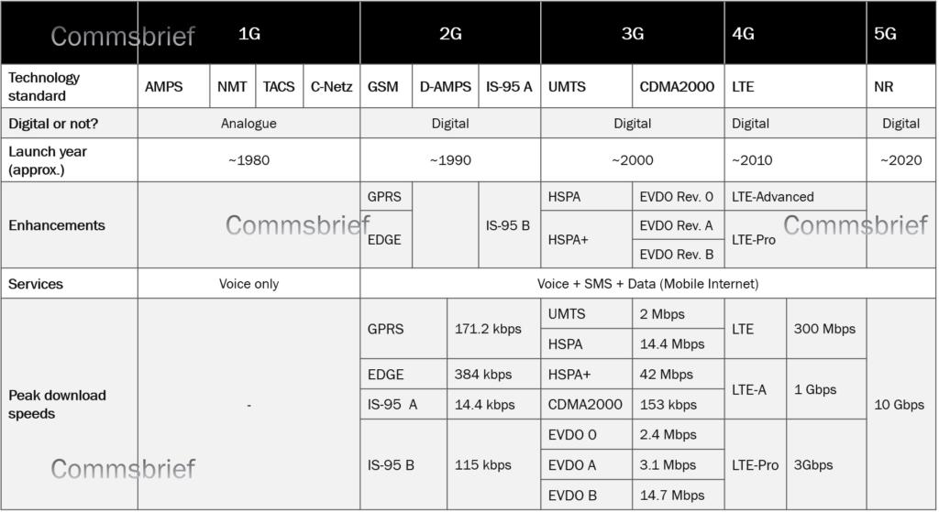

Slide 5
What is GSM ?
Global System for Mobile (GSM) is a second generation cellular standard developed to cater voice services and data delivery using digital modulation.

Slide 6
GSM: History
• Developed by Group Spéciale Mobile (founded 1982) which was an initiative of CEPT ( Conference of European Post and Telecommunication )
• Aim : to replace the incompatible analog system
• Presently the responsibility of GSM standardization resides with special mobile group under ETSI ( European telecommunication Standards Institute )
Full set of specifications phase-I became available in 1990
• Under ETSI, GSM is named as “ Global System for Mobile communication “
• Today many providers all over the world use GSM (more than 135
countries in Asia, Africa, Europe, Australia, America)
• More than 1300 million subscribers in world and 45 million subscriber in India.

Slide 7
GSM Services
GSM follows the Integrated Service Digital Network (ISDN) guidelines and classified as either teleservices or data-services.
Tele-services
Bearer or Data Services
Supplementary services

Slide 8
Tele Services
• Telecommunication services that enable voice communication
via mobile phones
• Offered services
- Mobile telephony
- Emergency calling
- facsimile (FAX)

Slide 9
Bearer Services/Data services
Include various data services for information transfer between GSM and other networks like PSTN, ISDN etc at rates from 300 to 9.6 kbps
Short Message Service (SMS)
up to 160 character alphanumeric data transmission to/from the mobile terminal
Unified Messaging Services(UMS): enables users to use voice mail and other features
Group 3 fax
Voice mailbox
Electronic mail

Slide 10
Supplementary Services
Call related services :
Call Waiting- Notification of an incoming call while on the handset
Call Hold- Put a caller on hold to take another call
Call Barring- All calls, outgoing calls, or incoming calls
Call Forwarding- Calls can be sent to various numbers defined by the user
Multi Party Call Conferencing - Link multiple calls together
CLIP – Caller line identification presentation
CLIR – Caller line identification restriction
CUG – Closed user group

Slide 11
GSM System Architecture
Architecture & Interfaces
PSTN
ISDN
PDN
BSC
MS
BTS
MSC
GMSC
BTS
BSC
VLR
MS
BTS
EIR
AUC
MS
HLR

Slide 12
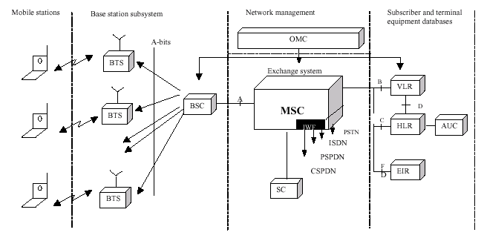
GSM architecture
Mobile Switching Center (MSC)
Home Location Register (HLR)
Visitor Location Register (VLR)
Authentication Center (AUC)
Equipment Identity Register (EIR)

Slide 13
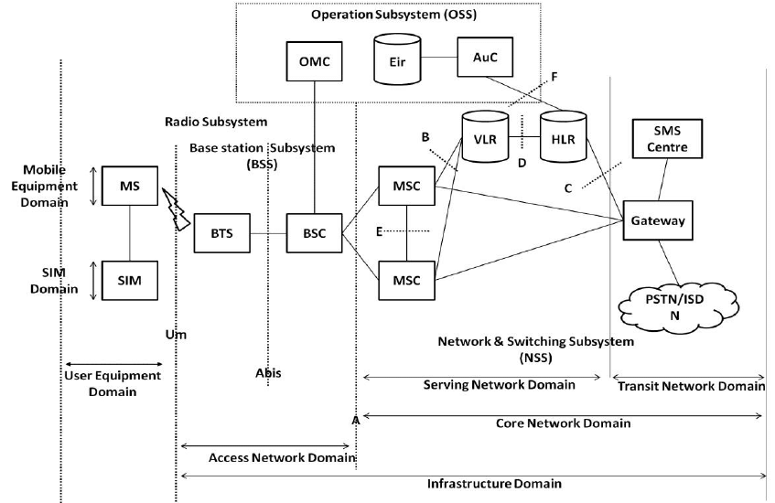
Interfaces used in GSM
Figure: The various Interfaces used in GSM

Slide 14
GSM System Architecture-I
Mobile Station (MS)
Mobile Equipment (ME)
Subscriber Identity Module (SIM)
Base Station Subsystem (BSS)
Base Transceiver Station (BTS)
Base Station Controller (BSC)
Network Switching Subsystem(NSS)
Mobile Switching Center (MSC)
Home Location Register (HLR)
Visitor Location Register (VLR)
Authentication Center (AUC)
Equipment Identity Register (EIR)

Slide 15
System Architecture Mobile Station (MS)
The Mobile Station is made up of two entities:
Mobile Equipment (ME)
2. Subscriber Identity Module (SIM)

Slide 16
System Architecture Mobile Station (MS)
Mobile Equipment
Portable,vehicle mounted, hand held device
Uniquely identified by an IMEI (International Mobile Equipment Identity)
Voice and data transmission
Monitoring power and signal quality of surrounding cells for optimum handover
Power level : 0.8W – 20 W
160 character long SMS.

Slide 17
System Architecture Mobile Station (MS) contd.
Subscriber Identity Module (SIM)
Smart card contains the International Mobile Subscriber Identity (IMSI)
Temporary Mobile Subscriber Identity (TMSI)
Allows user to send and receive calls and receive other subscribed services
Encoded network identification details
- Key Ki,Kc and A3,A5 and A8 algorithms
Protected by a password or PIN
Can be moved from phone to phone – contains key information to activate the phone

Slide 18
System Architecture Base Station Subsystem (BSS)
Base Station Subsystem is composed of two parts that communicate across the standardized Abis interface allowing operation between components made by different suppliers
Transcoder and Rate Adaptation Unit(TRAU)
Base Station Controller (BSC)
Base Transceiver Station (BTS)

Slide 19
Transcoder and Rate Adaptation Unit (TRAU)
The task of TRAU is to compress or decompress speech.
It compress speech from 64kbps to 16kbps
Typically it is located between the BSC and MSC but it can be placed between BTS and BSC

Slide 20
System Architecture Base Station Subsystem (BSS)
Base Transceiver Station (BTS):
Encodes, encrypts, multiplexes, modulates and feeds the RF signals to the antenna.
Frequency hopping
Communicates with Mobile station and BSC
Consists of Transceivers (TRX) units
The BTS provide the physical connection of an MS to the Network inform of Air interface “U_{m} ”
On the other side towards NSS ,the BTS is connected to the BSC via the Air interface “Abis”

Slide 21
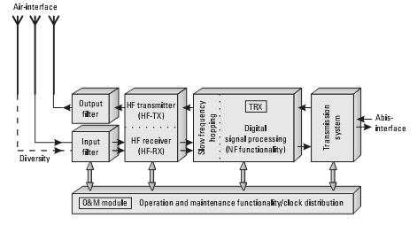
BTS Block Diagram

Slide 22
System Architecture Base Station Subsystem (BSS)
Base Station Controller (BSC)
Manages Radio resources for BTS
Assigns Frequency and time slots for all MS’s in its area
Handles call set up
Transcoding and rate adaptation functionality
Handover for each MS
Radio Power control
It communicates with MSC and BTS

Slide 23
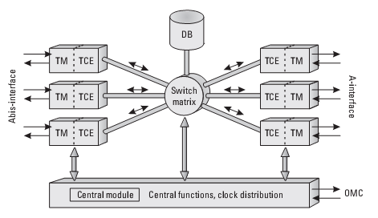
Architecture of BSC

Slide 24
Data Base (DB)
The BSC database contain the maintenance status of the whole BSS
It contain the complete BTS operations software for all attached BTSs

Slide 25
Central Module (CM)
The main task of CM is the Handover decision
It decide when a Handover should take place
For both intra BTS and intra BSC Handover decision BSC do not required the permission of MSC
Only for external Handover BSC needs to involve of MSC
Power control is also the main task of CM

Slide 26
System Architecture Network Switching Subsystem(NSS)
Mobile Switching Center (MSC)
Heart of the network
Manages communication between GSM and other networks
Call setup function and basic switching
Call routing
Billing information and collection
Mobility management
- Registration
- Location Updating
- Inter BSS and inter MSC call handoff
MSC does gateway function while its customer roams to other network by using HLR/VLR.

Slide 27
Network Switching Subsystem(NSS)

Slide 28
System Architecture Network Switching Subsystem
Home Location Registers (HLR)
- permanent database about mobile subscribers in a large service area(generally one per GSM network operator)
database contains IMSI, MSISDN, prepaid/ postpaid, roaming restrictions, supplementary services.
Visitor Location Registers (VLR)
Temporary database which updates whenever new MS enters its area, by HLR database
Controls those mobiles roaming in its area
Reduces number of queries to HLR
Database contains IMSI, TMSI, MSISDN, MSRN, Location Area, authentication key

Slide 29
System Architecture Network Switching Subsystem
Authentication Center (AUC)
Protects against intruders in air interface
Maintains authentication keys and algorithms and provides security triplets ( RAND, SRES, Kc)
Generally associated with HLR
Equipment Identity Register (EIR)
- Database that is used to track handsets using the IMEI (International Mobile Equipment Identity)
Made up of three sub-classes: The White List, The Black List and the Gray List
Only one EIR per PLMN

Slide 30
Equipment Identity Register – EIR

Slide 31
GSM Technical Specifications
RF Spectrum
GSM 900
Mobile to BTS (uplink/ reverse link): 890-915 Mhz
BTS to Mobile(downlink/ forward link):935-960 Mhz
Bandwidth : 2* 25 Mhz
GSM 1800
Mobile to BTS (uplink): 1710-1785 Mhz
BTS to Mobile(downlink) 1805-1880 Mhz
Bandwidth : 2* 75 Mhz

Slide 32
GSM Technical Specifications
Carrier Separation : 200 Khz
Duplex Distance : 45 Mhz
No. of RF carriers : 124
Method of Duplexing: FDD
Multiple Access Method : TDMA/FHMA
Modulation Method : 0.3 GMSK
Modulation data rate : 270.833 Kbps

Slide 33
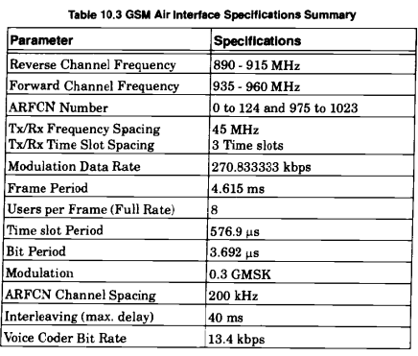

Slide 34
GSM Channels
Frame Structure
The physical channel in GSM is the timeslot.
The logical channel is the information which goes through the physical ch.
Both user data and signaling are logical channels.
User data is carried on the traffic channel (TCH) , which is defined as 26 TDMA frames.
There are lots of control channels(CCH) for signaling, base station to mobile, mobile to base station (“aloha” to request network access)

Slide 35
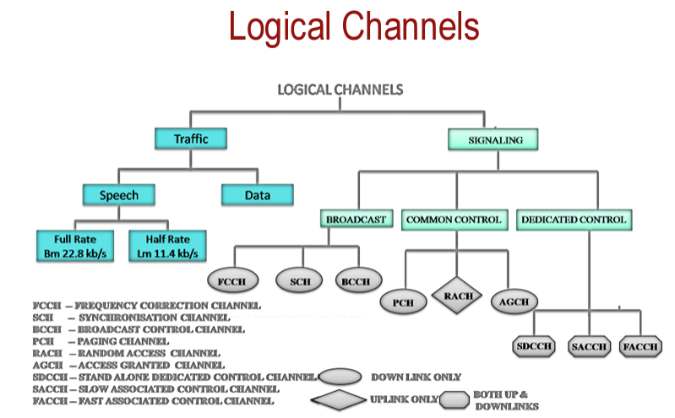

Slide 36

Physical and Logical Channels
The physical channel is the medium over which the information is carried,
The logical channels consist of the information carried over the physical channel
TDMA FRAME
0
1
2
3
4
5
6
7
0
Timeslot
The information carried in one time
slot is called a “burst”

Slide 37
Traffic Channel
TCH
Traffic Channels
Normal Burst
Speech
Data
TCH/FS
TCH/HS
TCH/9.6
TCH/2.4
TCH Traffic Channel
TCH/FS Full rate Speech Channel
TCH/HS Half rate Speech Channel
TCH/9.6 Data Channel 9.6kb/s
TCH/4.8 Data Channel 4.8kb/s
TCH/2.4 Data Channel 2.4Kb/s
TCH/4.8

Slide 38
Control Channel
CCH Control Channels
DCCH
BCCH
SDCCH
ACCH
Synch. CH.
BCCH
FACCH
SACCH
CCCH
SCH
FCCH
RACH
CBCH
PCH/AGCH
Broadcast Control Channel – BCCH
Common Control Channel – CCCH
Dedicated Control Channel – DCCH
Associated Control Channel – ACCH

Slide 39
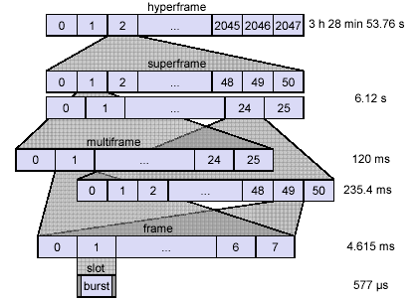
GSM-Frame Structure

Slide 40
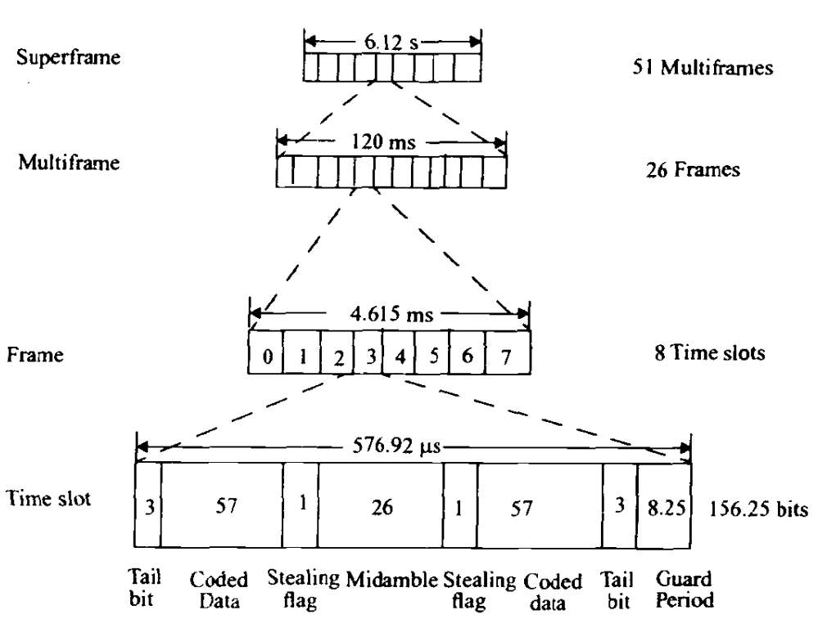
Fig: GSM-Frame Structure

Slide 41
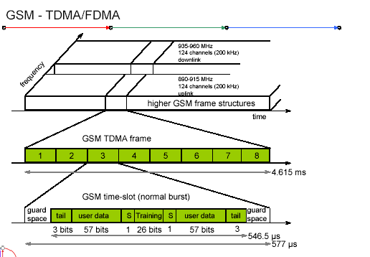

Slide 42
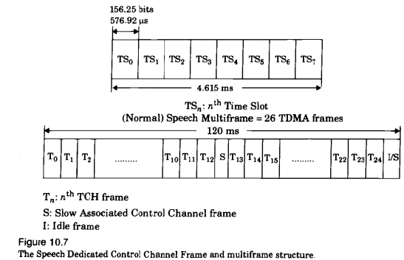

Slide 43
GSM Multiframe
TDMA Frames
0
1
0
1
2
3
4
5
6
7
0
1
2
3
4
5
6
7
0
1
2
3
4
21
22
23
24
25
26 – Frame Multiframe (120ms)
TRAFFIC CHANNELS

Slide 44
GSM Multiframe
TDMA Frames
0
1
0
1
2
3
4
5
6
7
0
1
2
3
4
5
6
7
0
1
2
3
4
46
47
48
49
50
51 – Frame Multiframes (235.3ms)
CONTROL CHANNELS

Slide 45
Timeslots and TDMA Frames
Higher Capacity Cell
0
1
2
3
4
5
6
7
0
Broadcast
Traffic
Dedicated
0
1
2
3
4
5
6
7
0
Traffic
Low Capacity Cell
0
1
2
3
4
5
6
7
0
Combined
Traffic

Slide 46
GSM Burst
The timeslots are termed burst periods because the GSM transmitter must transmit its data in a short “burst” within the time slot
Random Access burst (RACH): Used in MS initial access
Frequency correction burst (FCH): Used in frequency synchronization between MS and BTS
Synchronous burst (SCH): Used in timing synchronization between MS and BTS

Slide 47
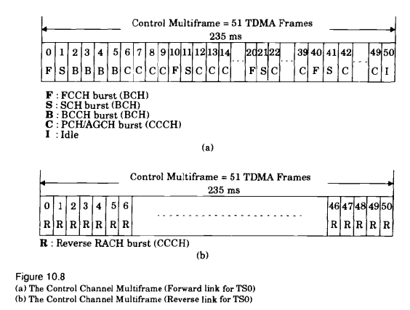
Frequency Correction Channel
Synchronization Channel
Broadcast Control channel
Common Control Channel

Slide 48
BURST Frame Format
Random Access burst (RACH): Used in MS initial access
Tail bit
Data
Tail bit
Guard interval
8bit
41 synchronous bits
36 encrypted bits
3bit
68.25bit
Frequency correction burst (FCH): Used in frequency synchronization between MS and BTS
Tail bit
Data
Tail bit
Guard interval
3bit
142bit
3bit
8.25bit
Synchronous burst (SCH): Used in timing synchronization between MS and BTS
Tail bit
Data
Data
Tail bit
Guard interval
3bit
39 encrypted bits
64 synchronous bits
39 encrypted bits
3bit
8.25bit

Slide 49
Burst Mapping on physical channel
0
7
0
7
0
7
f
s
s
TDMA frame = 4.615 ms
Burst (148 bits)
Guard
Interval
(8.25 bits)
577µs (156.25 bits)

Slide 50
GSM-Frame Structure

Slide 51
Fig: GSM-Frame Structure

Slide 53
Control Channels in GSM:
BCH: Broadcast Control Channel
CCCH: Common Control Channel
DCCH: Dedicated Control Channel

Slide 54
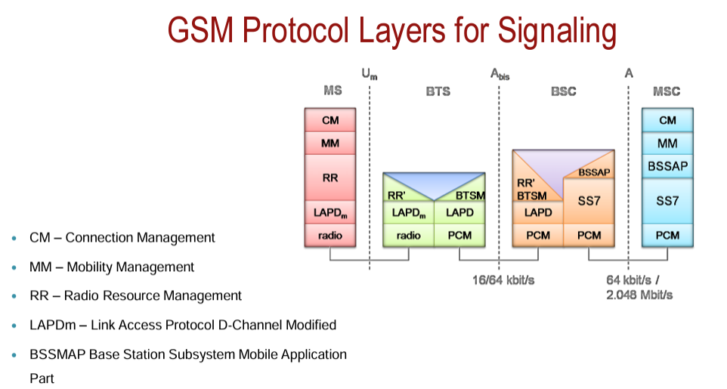

Slide 55
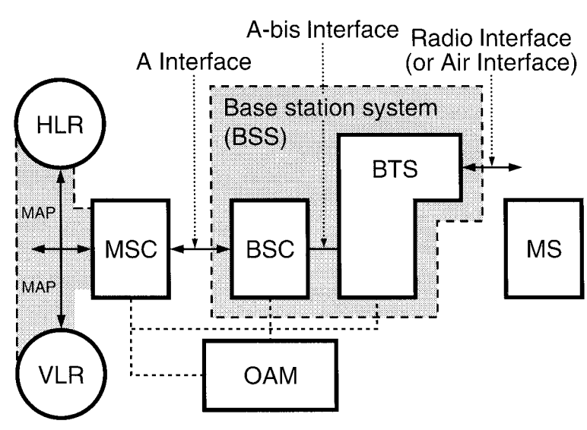

Slide 56
The following functions are parts of the CM layer:
1. Call control. The CM layer sets up calls, maintains calls, and releases calls. The CM layer interacts among the MSC/VLR, GMSC, IWF, and HLR for managing circuit-oriented service, including speech and circuit data.
2. Supplementary services management. Allows users to have some control of their calls in the network, and has specific variations from the basic service.
3. Short message service (SMS). Related to the point-to-point SMS. A SMS service center (SMS-SC) may connect to several GSM networks. Short message transmission requires setting up a signaling connection between the mobile station and the MSC.
The two functions of SMS are
a. Mobile-originating short message
b. Mobile-terminating short message
OSS is an integral part of the OAM layer. All the subsystems, such as BBS and NSS, contribute to the OAM operation and maintenance functions

Slide 57
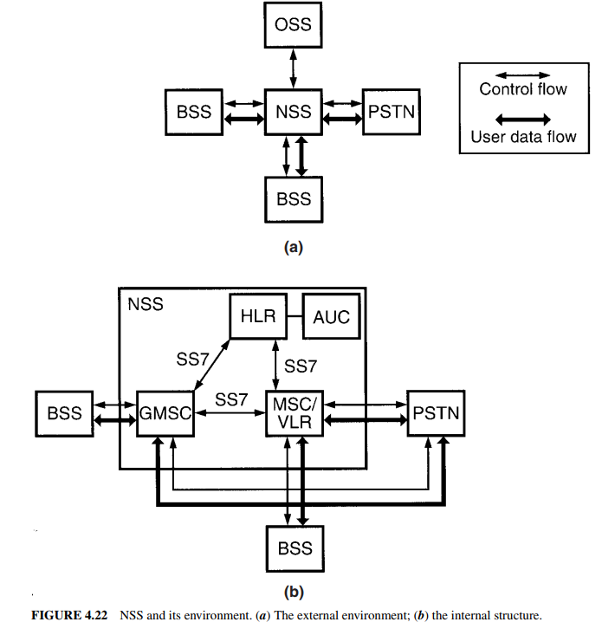

Slide 58
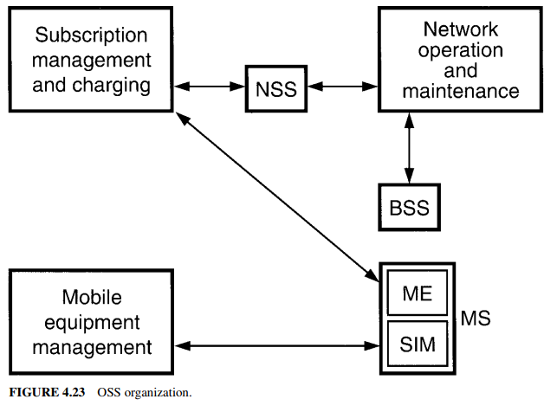

Slide 59
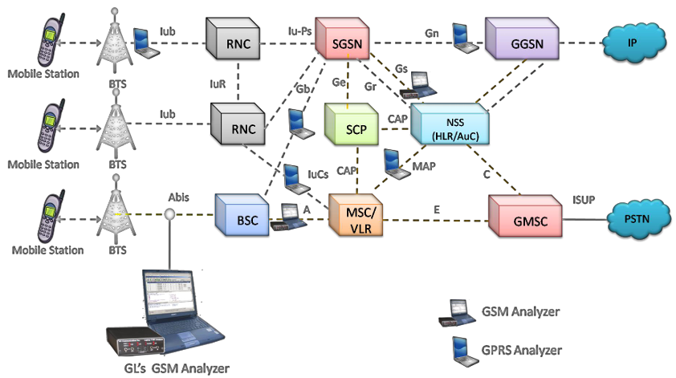
GSM PROTOCOLS analyser

Slide 60
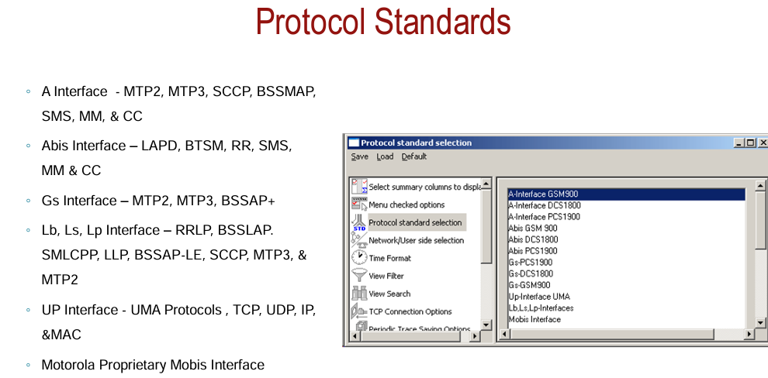

Slide 61
Call Routing
Call Originating from MS
Call termination to MS

Slide 62
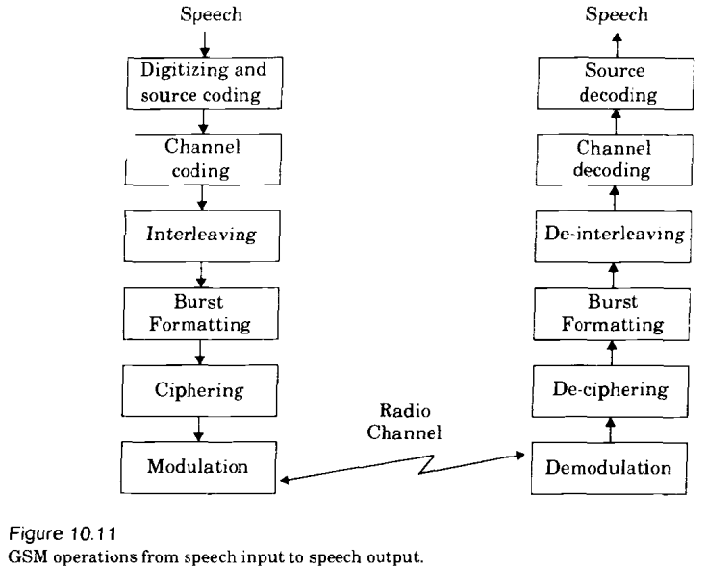

Slide 63
Speech. A 4-kHz analog speech signal converts to a 64-kbps digital signal, then down-converts to 13 kbps before modulation.
Using a rate of 13 kbps instead of 64 kbps allows the 13-kbps data rate transmission to occur over a narrowband channel
Digital speech uses:
1. Regular pulse excitation (RPE): Generates the impulse noise to simulate the nature of speech.
2. Linear prediction coding (LPC): Generates speech waveform by using a filter with eight transmitted coefficients with a speech frame of 20 ms.
Modulation. Gaussian minimum-shift keying (GMSK), where BT = 0.3 is the
normalized bandwidth of a gaussian filter, is the modulation scheme of GSM, where B is the baseband bandwidth, and 1/T is the transmission rate. B = 1/T × 0.3 = 270 kbps × 0.3 = 81 kHz.
Minimum means the minimum tone separation.
The modulation rate of a GSM carrier channel is 270 kbps

Slide 64
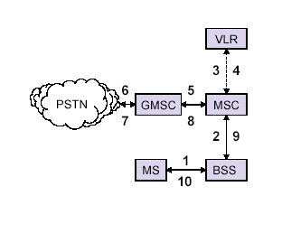
Outgoing Call
MS sends dialled number to BSS
BSS sends dialled number to MSC
3,4 MSC checks VLR if MS is allowed the requested service.If so,MSC asks BSS to allocate resources for call.
MSC routes the call to GMSC
GMSC routes the call to local exchange of called user
7, 8,
9,10 Answer back(ring back) tone is routed from called user to MS via GMSC,MSC,BSS

Slide 65
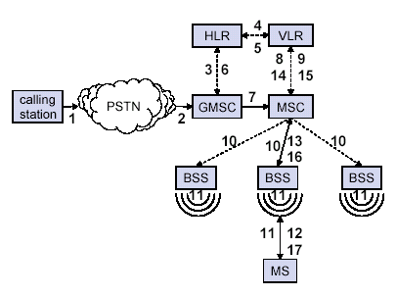
Incoming Call
Calling a GSM subscribers
Forwarding call to GSMC
Signal Setup to HLR
5. Request MSRN from VLR
Forward responsible MSC to GMSC
Forward Call to current MSC
9. Get current status of MS
11. Paging of MS
13. MS answers
15. Security checks
17. Set up connection

Slide 66
Authentication and Security in GSM

Slide 67
GSM Security Requirements
Network provider‘s view
correct Billing: authenticity of the user
no misuse of the service, correct billing of content-usage
efficiency: no more bandwidth needed for security, no long delays (user acceptance), cost-efficient
User‘s view
confidentiality of communication (voice and data)
privacy, no profiles of the movements of the users
connection with authentic base station
correct billing
Content provider‘s view
correct billing

Slide 68
Security in GSM
On air interface, GSM uses encryption and TMSI instead of IMSI.
SIM is provided 4-8 digit PIN to validate the ownership of SIM
3 algorithms are specified :
- A3 algorithm for authentication
- A5 algorithm for encryption
- A8 algorithm for key generation

Slide 69
Overview of GSM Security Services
Smartcard-based authentication of the user
Identification of the through worldwide unique name IMSI
Algorithm A3 for authentication is not public,
Confidentiality on the radio link:
Algorithms: up to 7 A5 variants
unique, permanent subscriber key Ki and
dynamicly generated communication keys Kc
Anonymity:
use of temporary identities
Notes:
Zu klären: Qualität der Verfahren, des Schlüsselmanagements?
zu klären: Privacy damit ausreichend?

Slide 70
Authentication
MS
Network
Um interface
Ki
RAND
RAND
Ki
A3
A3
SRES
=?
SRES
Ki = authentication key
RAND = random number
SRES = Signal Response
Accept / reject?

Slide 71
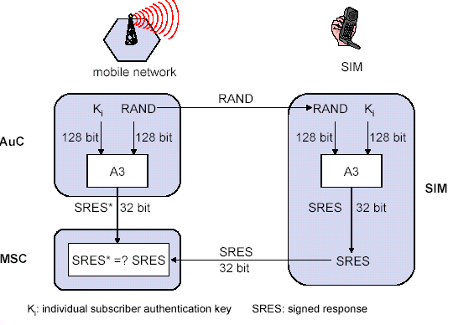
Authentication in GSM

Slide 72
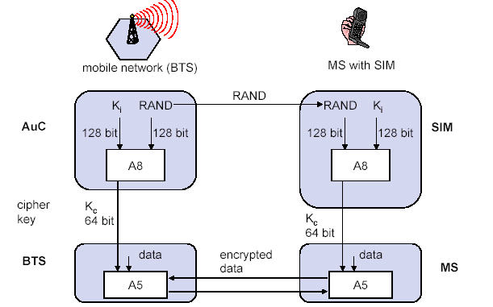
Key generation and Encryption
IMSI
TMSI
PIN
MSISDN

Slide 73
Characteristics of GSM Standard
Fully digital system using 900,1800 MHz frequency band.
TDMA over radio carriers(200 KHz carrier spacing.
8 full rate or 16 half rate TDMA channels per carrier.
User/terminal authentication for fraud control.
Encryption of speech and data transmission over the radio path.
Full international roaming capability.
Low speed data services (upto 9.6 Kb/s).
Compatibility with ISDN.
Support of Short Message Service (SMS).

Slide 74
Advantages of GSM over Analog system
Capacity increases
Reduced RF transmission power and longer battery life.
International roaming capability.
Better security against fraud (through terminal validation and user authentication).
Encryption capability for information security and privacy.
Compatibility with Integrated Services Digital Network(ISDN) , leading to wider range of services

Slide 75
GSM Applications
Mobile telephony
GSM-R
Telemetry System
- Fleet management
- Automatic meter reading
- Toll Collection
- Remote control and fault reporting of DG sets
Value Added Services

Slide 76
Future Of GSM
2nd Generation
GSM -9.6 Kbps (data rate)
2.5 Generation ( Future of GSM)
HSCSD (High Speed ckt Switched data)
Data rate : 76.8 Kbps (9.6 x 8 kbps)
GPRS (General Packet Radio service)
Data rate: 14.4 - 115.2 Kbps
EDGE (Enhanced data rate for GSM Evolution)
Data rate: 547.2 Kbps (max)
3 Generation
WCDMA(Wide band CDMA)
Data rate : 0.348 – 2.0 Mbps

Slide 77
Signal Strength
Signal strength (in dB)
Cell i
Cell j
-60
-60
-70
-70
-80
-80
-90
-90
-100
-100
Select cell i on left of boundary
Select cell j on right of boundary
Ideal boundary

Slide 78
Signal Strength
Signal strength (in dB)
Cell i
Cell j
-60
-70
-60
-80
-70
-90
-80
-90
-100
-100
Signal strength contours indicating actual cell tiling. This happens because of terrain, presence of obstacles and signal attenuation in the atmosphere.

Slide 79
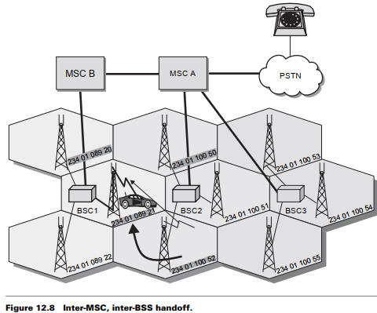

Slide 80
Handoff Region
Signal strength due to BS_{i}
Signal strength due to BS_{j}
P_{i}(x)
P_{j}(x)
E
P_{min}
BS_{i}
MS
BS_{j}
X₁
X₃
X₅
X_{th}
X₄
X₂
By looking at the variation of signal strength from either base station it is possible to decide on the optimum area where handoff can take place.

Slide 81
Handoff Region
Signal strength deterioration is the most common cause
load balancing where the handoff is network initiated to relieve traffic congestion.
The handoff could be synchronous or it may be asynchronous
Handoffs are either initiated by the base station controller (BSC), based upon radio subsystem criteria such as RF level (RXLEV), signal quality (RXQUAL) or distance, or they are a result of network traffic loading.

Slide 82
Handover decision
receive level
BTS_{old}
receive level
BTS_{old}
HO_MARGIN
MS
MS
BTS_{old}
BTS_{new}

Slide 83
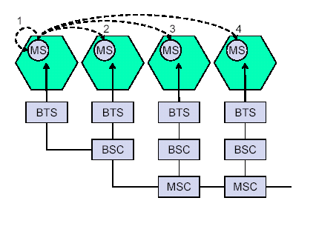
Handovers/ Handoffs
Between 1 and 2 – Inter BTS / Intra BSC
Between 1 and 3 –
Inter BSC/ Intra MSC
Between 1 and 4 –
Inter MSC

Slide 84
Personal Communication System (PCS)
Problems with cellular structure
How to maintain continuous communication between two parties in the presence of mobility?
Solution: Handoff
How to maintain continuous communication between two parties in the presence of mobility?
Solution: Roaming
How to locate of a mobile unit in the entire coverage area?
Solution: Location management

Slide 85
Personal Communication System (PCS)
Handoff
A process, which allows users to remain in touch, even while breaking the connection with one BS and establishing connection with another BS.

Slide 86
Personal Communication System (PCS)
Handoff
To keep the conversation going, the Handoff procedure should be completed while the MS (the bus) is in the overlap region.

Slide 87


Introduction – Use Case 1
BSC
BS1
BS2
BS3
1. Connect to BS1 and start conversation
2. Moving out of BS1’s coverage – connect to BS2
3. Moving out of BS2’s coverage – connect to BS3
4. Conversation ended – still within BS3’s coverage
Tor K Moseng, Handoff in Wireless Internet Access

Slide 88

Handover in GSM
Horizontal Handover
Network-controlled, mobile terminal assisted handover
The network takes the handover decisions
The mobile terminal supervises and reports its signal quality
Three types of handover
Intra-BSC handover
Inter-BSC handover
Inter-MSC handover
MSC
MSC
BSC
BSC
BSC
BSC
Tor K Moseng, Handoff in Wireless Internet Access
Notes:
MSC: Mobile Switching Centre
Intra-BSC handover
Involves only the BSC
Inter-BSC handover
Signalling up to the MSC
Inter-MSC handover
More complex when handover to another MSC is performed

Slide 89
Hard Handover
Handover Approaches
”break before make”
Old connection is broken before a new connection is activated
Primarily used in FDMA and TDMA systems (e.g. GSM)
Different frequency ranges used in adjacent cells to minimize the interference
When to perform hard handover?
E.g. based on measurements of the signal quality
Different schemes to avoid unnecessary handovers
Tor K Moseng, Handoff in Wireless Internet Access
Notes:
FDMA: Frequency Division Multiple Access
TDMA: Time Division Multiple Access
Basing the handover on only signal strength is observed to give too many unneccessary handovers
Thresholds may say when signal is sufficiently weak
Margins may say when new signal is stronger by a given margin

Slide 90
Handoff types with reference to link transfer
Hard handoff
The MS connects with only one BS at a time, and there is usually some interruption in the conversation during the link transition.
Soft handoff
The two BSs are briefly simultaneously connected to the MU while crossing the cell boundary. As soon as the mobile's link with the new BS is acceptable, the initial BS disengages from the MU.

Slide 91
Personal Communication System (PCS)
Handoff types with reference to link transfer
Hard handoff
MU temporarily suspends the voice conversation by sending a link suspend message to the old BS.
MU sends a handoff request message through an idle time slot of the new BS to the network.
The new BS sends a handoff ack message and marks the slot busy.
The MU returns the old assigned channel by sending a link resume message to the old BS.

Slide 92
Personal Communication System (PCS)
Handoff types with reference to link transfer
Hard handoff
MU continues voice communication while the network prepares for the handoff.
Upon receipt of a handoff request message, the new BS sends a handoff ack message and reconfigures itself to effect the handoff.
The MSC inserts a bridge into the conversation path and bridges the new BS.
Finally, the network informs the MU to execute the handoff via both the new and old BSs by sending the handoff execute message.

Slide 93
Personal Communication System (PCS)
Handoff types with reference to link transfer
Hard handoff
MU releases the old channel by sending an access release message to the old BS.
Once the MU has made the transfer to the new BS, it sends the network a handoff complete message through the new channel, and resumes the voice communication. The network removes the bridge from the path and frees up the resources associated with the old channel.

Slide 94
Soft Handover
Handover Approaches
”make before break”
New connection is activated before the old is broken
Used in UMTS to improve the signal quality
Uplink and downlink signals may be combined for better signal
A mobile may in UMTS spend a large part of the connection time in soft handover
Better connection reliability
More seamless handover
Tor K Moseng, Handoff in Wireless Internet Access
Notes:
CDMA (Code Division Multiple Access)
SHO appears to a CDMA-MS as multipath components, but with different spreading codes
When a base station’s signal exceeds a defined threshold, it is added to the active set of base stations in the mobile station
Handovers in CDMA fundamentally different from TDMA
UMTS
Trade-off: Improved mobility but more interference from transmitting same flow over several connections (possibly more Node Bs)

Slide 95
Personal Communication System (PCS)
Handoff types with reference to link transfer
Soft handoff
MU sends a pilot strength measurement message to the old BS, indicating the new BS to be added.
The old BS sends a handoff request message to the MSC. If the MSC accepts the handoff request, it sends a handoff request message to the new BS.
The BS sends a null traffic message to the MU to prepare the establishment of the communication link.

Slide 96
Personal Communication System (PCS)
Handoff types with reference to link transfer
Soft handoff
The new BS sends a join request message to the MSC. The MSC bridges the connection for the two BSs, so that the handoff can be processed without breaking the connection.
The new BS sends a handoff ack message to the old BS via the MSC. The old BS instructs the MU to add a link to the new BS by exchanging the handoff command and handoff complete messages.

Slide 97
Personal Communication System (PCS)
Handoff types with reference to link transfer
Soft handoff
The old BS and the MSC conclude this procedure by exchanging the required handoff information. The quality of the new link is guaranteed by the exchange of the pilot measurement request and the pilot strength measurement message pair between the MU and the new BS.

Slide 98
4 types of handover
1
2
3
4
MS
MS
MS
MS
BTS
BTS
BTS
BTS
BSC
BSC
BSC
MSC
MSC

Slide 99
Personal Communication System (PCS)
Handoff detection strategies
Mobile-Controlled handoff (MCHO)
Network-Controlled handoff (NCHO)
Mobile-Assisted handoff (MAHO)

Slide 100
Personal Communication System (PCS)
Mobile-Controlled Handoff (MCHO)
In this strategy, the MS continuously monitors the radio signal strength and quality of the surrounding BSs. When predefined criteria are met, then the MS checks for the best candidate BS for an available traffic channel and requests the handoff to occur. MACHO is used in Digital Enhanced Cordless Telecommunications(DECT) and Personal Access Communications System (PACS).

Slide 101
Personal Communication System (PCS)
Network-Controlled Handoff (NCHO)
In this strategy, the surrounding BSs, the MSC or both monitor the radio signal. When the signal’s strength and quality deteriorate below a predefined threshold, the network arranges for a handoff to another channel. NCHO is used in cordless telephony (CT-2) Plus and Advanced Mobile Phone System (AMPS).

Slide 102
Personal Communication System (PCS)
Mobile-Assisted Handoff (MAHO)
It is a variant of NCHO strategy. In this strategy, the network directs the MS to measure the signal from the surrounding BSs and to report those measurements back to the network. The network then uses these measurements to determine where a handoff is required and to which channel. MACHO is used in GSM and Interim Standard-95 (IS-95) CDMA.

Slide 103
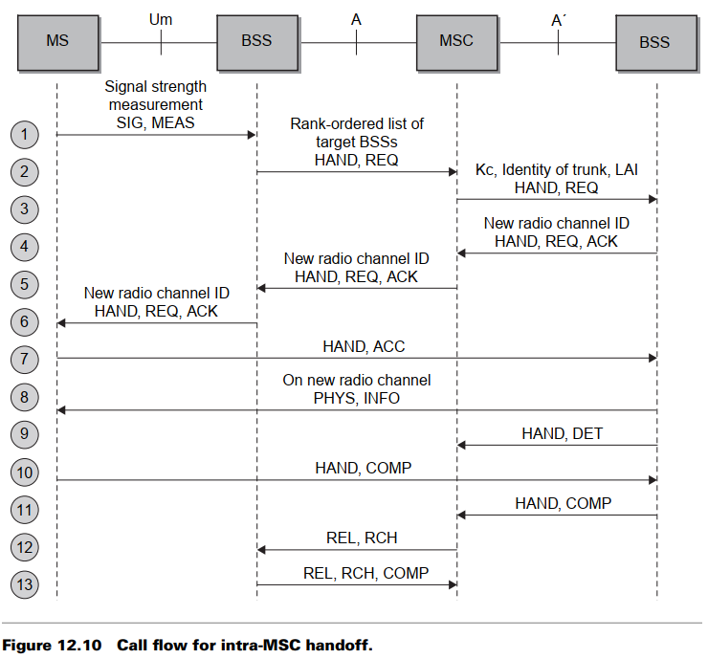

Slide 104
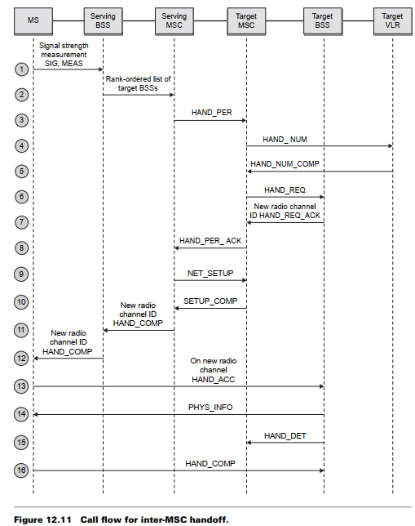

Slide 105
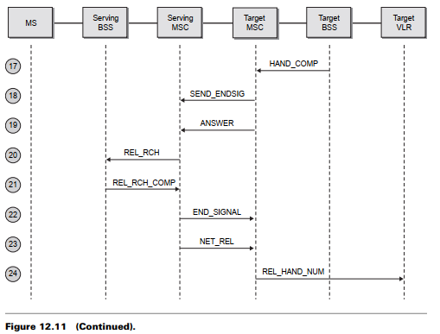

Slide 106
Personal Communication System (PCS)
Handoff types with reference to the network
Intra-system handoff or Inter-BS handoff
The new and the old BSs are connected to the same MSC.

Slide 107
Personal Communication System (PCS)
Intra-system handoff or Inter-BS handoff
Steps
The MU (MS) momentarily suspends conversation and initiates the handoff procedure by signaling on an idle (currently free) channel in the new BS. Then it resumes the conversation on the old BS.

Slide 108
Personal Communication System (PCS)
Intra-system handoff or Inter-BS handoff
Upon receipt of the signal, the MSC transfers the encryption information to the selected idle channel of the new BS and sets up the new conversation path to the MS through that channel. The switch bridges the new path with the old path and informs the MS to transfer from the old channel to the new channel.

Slide 109
Personal Communication System (PCS)
Intra-system handoff or Inter-BS handoff
After the MS has been transferred to the new BS, it signals the network and resumes conversation using the new channel.

Slide 110
Personal Communication System (PCS)
Intra-system handoff or Inter-BS handoff
Upon the receipt of the handoff completion signal, the network removes the bridge from the path and releases resources associated with the old channel.

Slide 111
Personal Communication System (PCS)
Handoff types with reference to the network
Intersystem handoff or Inter-MSC handoff
The new and the old BSs are connected to different MSCs.

Slide 112
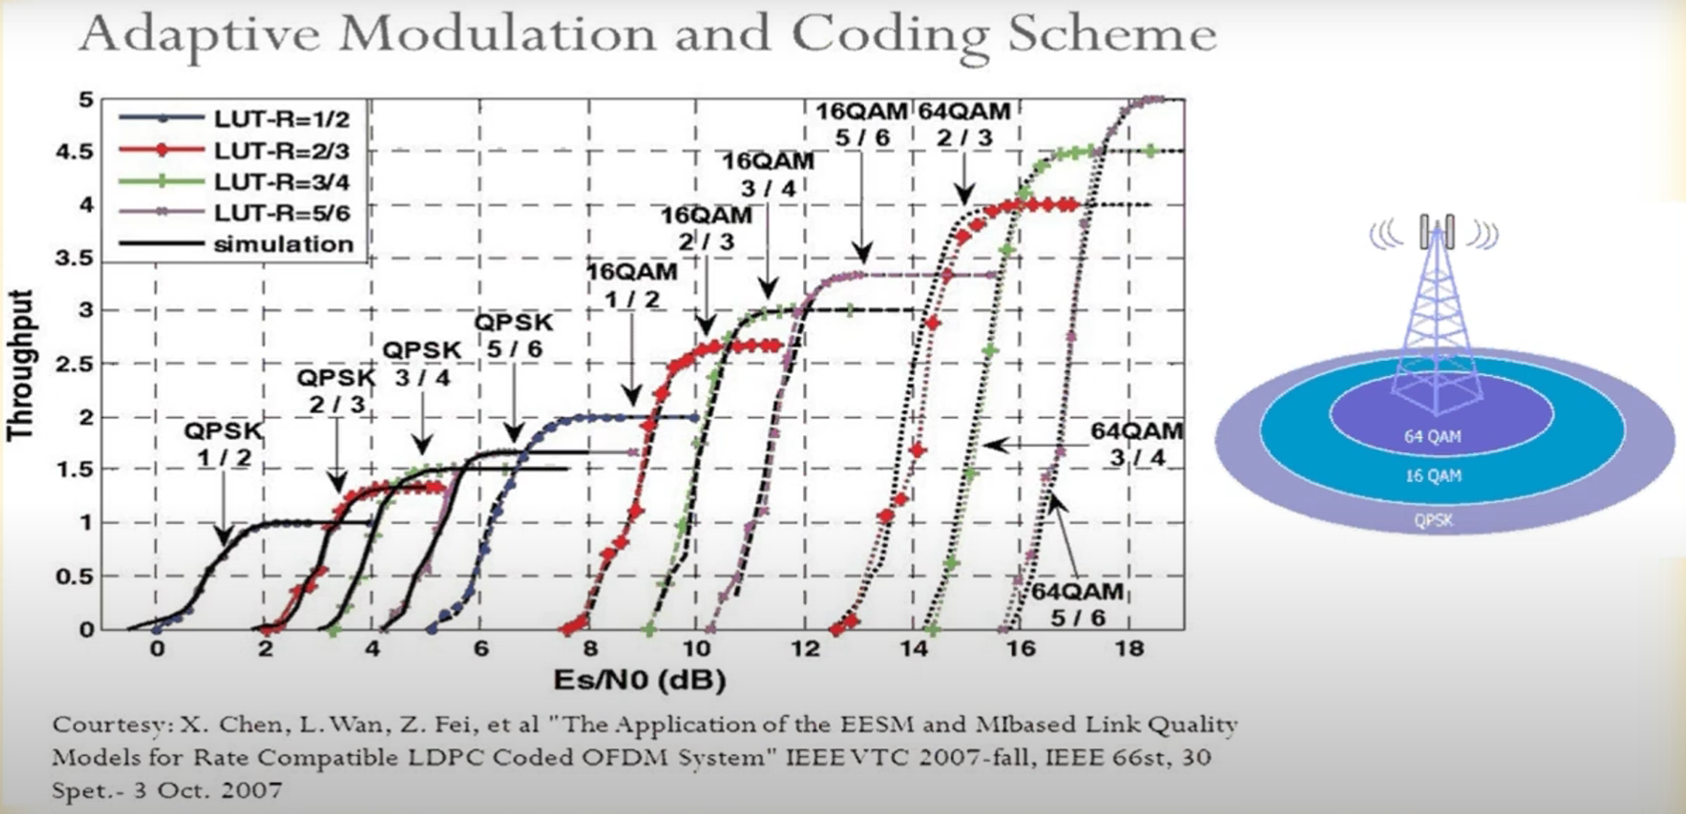

Slide 113
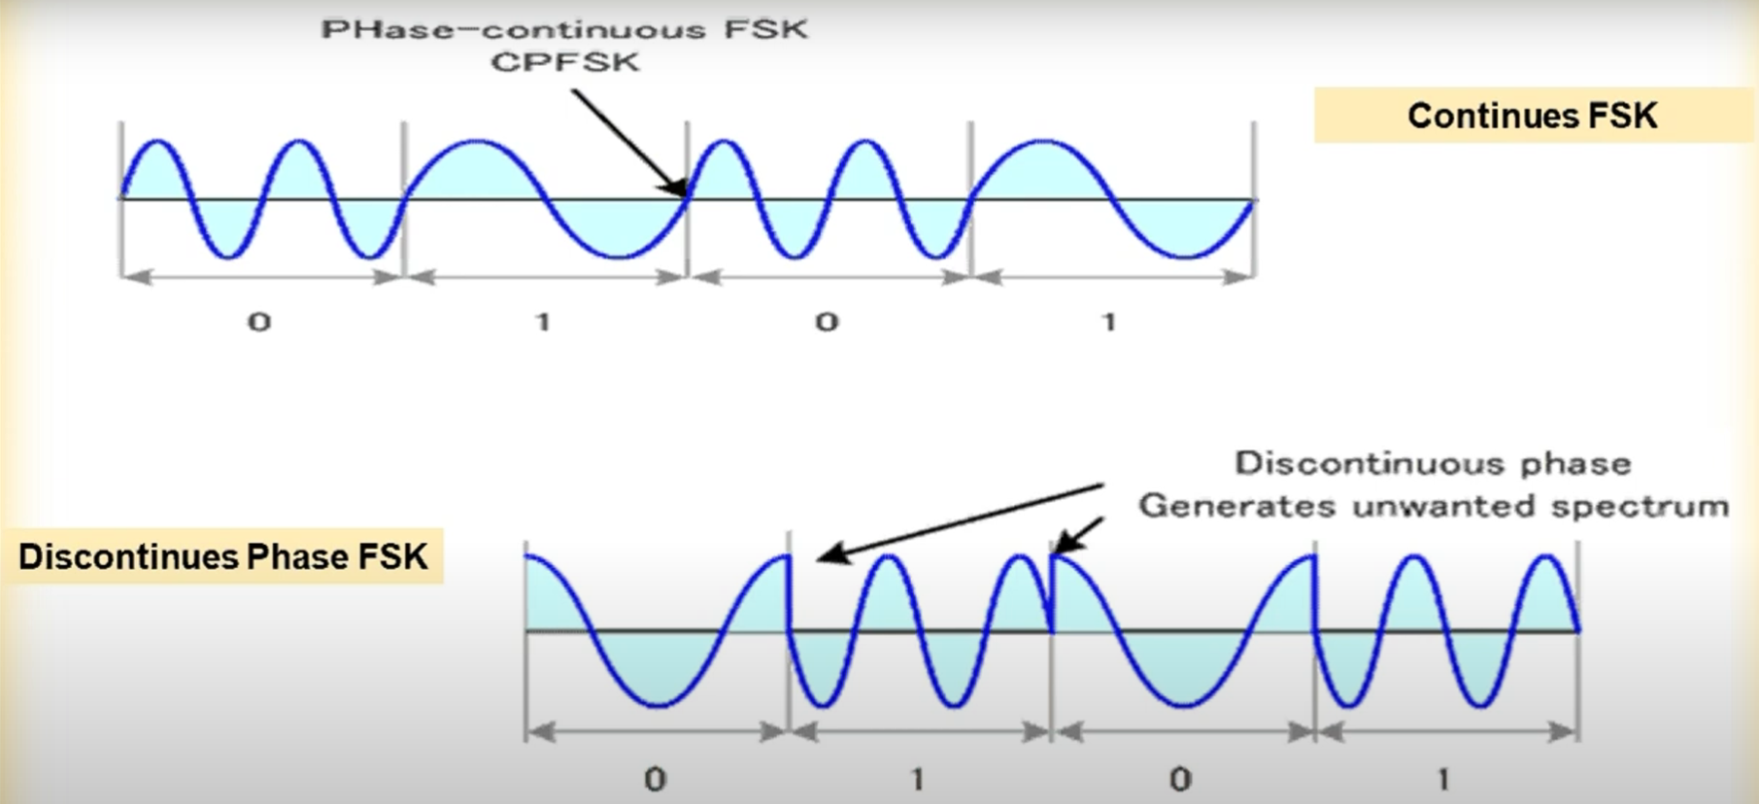

Slide 114
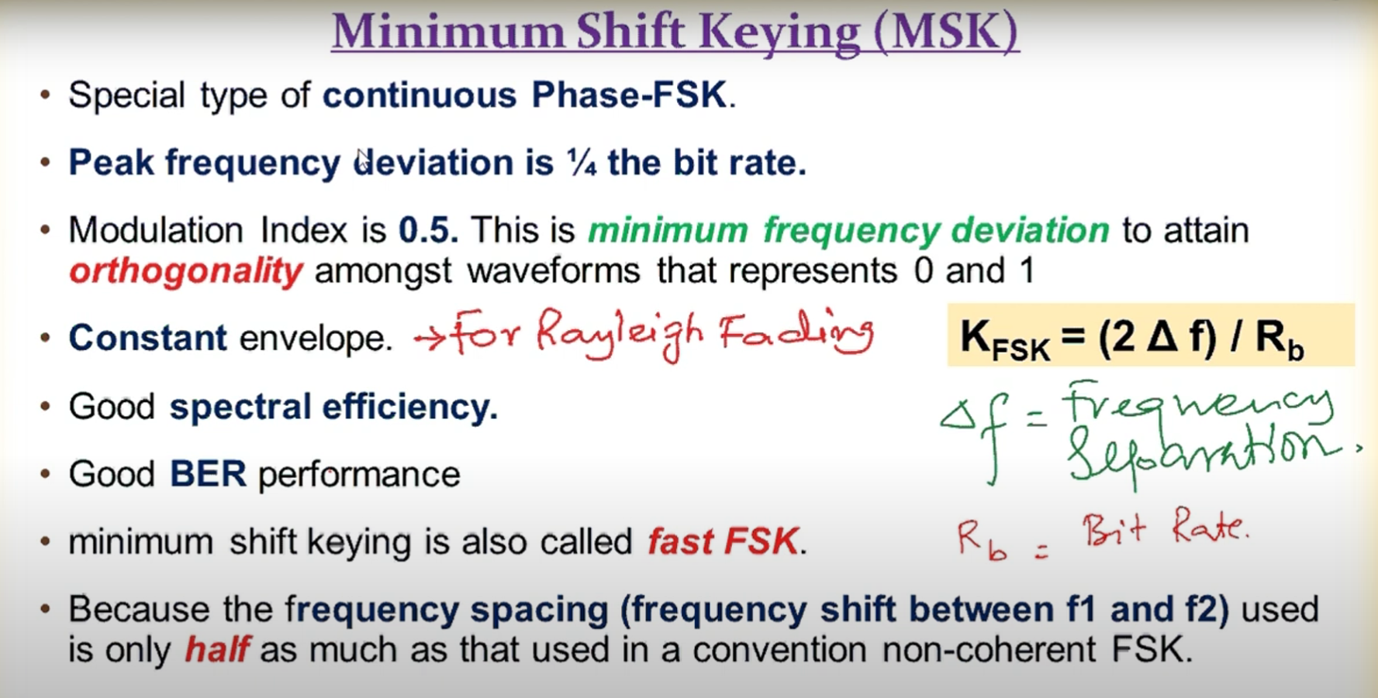

Slide 115
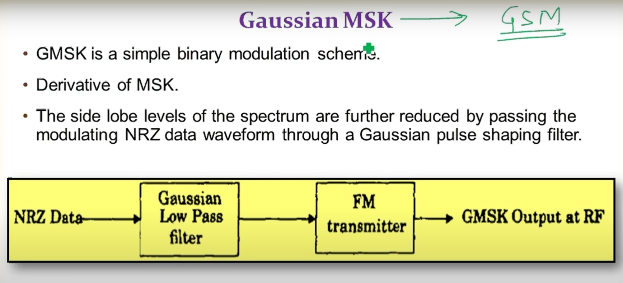

Slide 116
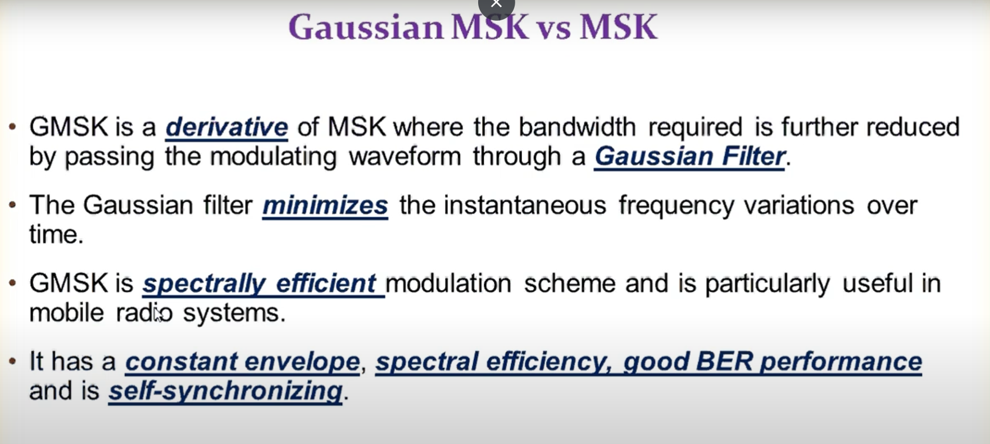

Slide 117
